Slide 1


Slide 2


MASGNA 2025 Fall Hybrid Conference
GLP-1 Drugs and Anesthesia Concerns in the Endoscopy Suite
Catherine Cooper, MD
Anesthesiologist, VCU Health System
Medical Director, Stony Point Endoscopy

Slide 3

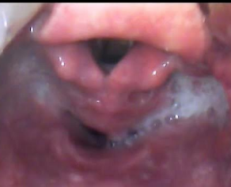
Anesthesia Concerns in Endoscopy
It’s All About the Airway
GLP-1 agonist use is now common for both diabetes and weight loss (1 in 8 adults in the US)
Profound effects on entire GI tract
Concern for delayed gastric emptying
  Colon doesn’t empty well either
Controversy among medical providers about risk and need to stop drugs prior to anesthesia for surgery or procedures
Guidelines from 2023 and 2024

Slide 4
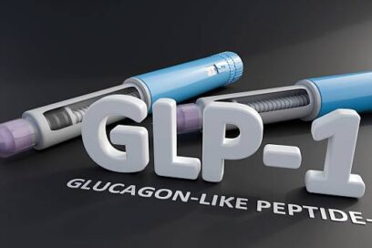

GLP-1 Agonist Drugs
Semaglutide
  Ozempic® Wegovy ® Rybelsus®
Tirzepatide
  Mounjaro ® Zepbound ®
Liraglutide
  Saxenda ® Victoza ®
Dulaglutide
  Trulicity ®
Can be administered orally (daily) or by weekly injection
Used for diabetes: Ozempic, Mounjaro
Used for weight loss: Wegovy, Zepbound
^{Used for heart disease}

Slide 5
What are GLP-1 drugs?
Glucagon-Like-Peptide-1 agonists – mimic natural GLP-1 which suppresses glucagon secretion
Glucagon raises the blood sugar:
  Glycogenolysis Increases blood glucose by stimulating the liver to release stored glucose (glycogen) into the bloodstream
  Gluconeogenesis Signals the liver to produce glucose from other sources, such as amino acids and fatty acids
  Prevents hypoglycemia: glucagon released to raise blood sugar
  Suppresses insulin secretion
  Also relaxes smooth muscle in the GI tract, particularly biliary tract and sphincter

Slide 6
Encretin Hormones: GLP-1 and GIP
Gastric inhibitory polypeptide (GIP) and glucagon‐like peptide‐1 (GLP‐1) are the two primary incretin hormones secreted from the intestine on ingestion of glucose or nutrients to stimulate insulin secretion from pancreatic β cells.
Diabetics have impaired GLP-1 function and benefit from GLP-1 agonists with improved A1C levels, cardioprotective effect, renal benefits

Slide 7
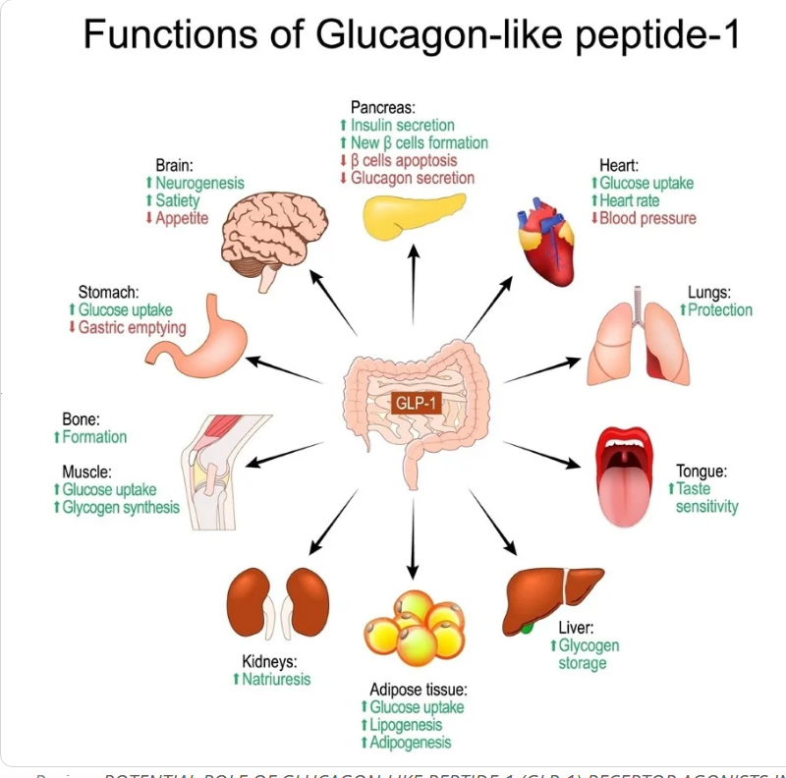
What does natural GLP-1 do?
Naturally occurring hormone glucagon-like peptide-1 (GLP-1),
made in the small intestine, along with
  Antagonizes the blood sugar raising effect of glucagon
  Stimulates insulin release
  Blocks the release of glucagon
  Slows down stomach emptying
  Increases feelings of fullness (satiety)
  Reduces appetite

Slide 8
GLP-1 Drugs
GLP-1 drugs treat Type 2 diabetes and obesity:
  Increase insulin secretion, suppress glucagon release, slow gastric emptying, suppress appetite
Significant GI and other side effects
Nausea Indigestion Dizziness Pancreatitis
Vomiting Bloating Headache Gastroparesis
Diarrhea Burping/ gas Fatigue Bowel obstruction
Abdominal pain Hypoglycemia GERD Biliary disease
Constipation Gastroenteritis Hair loss

Slide 9
Severe GI risks with GLP-1 drugs
Events resulting in an inpatient and/or emergency department encounter:
  Acute pancreatitis
  Biliary and gall bladder disease: suppresses secretion of cholecystokinin leading to stones, obstruction, stenosis, colic, fistula, cyst, or cholangitis
  Bowel obstruction
  Gastroparesis
  Severe constipation

Slide 10
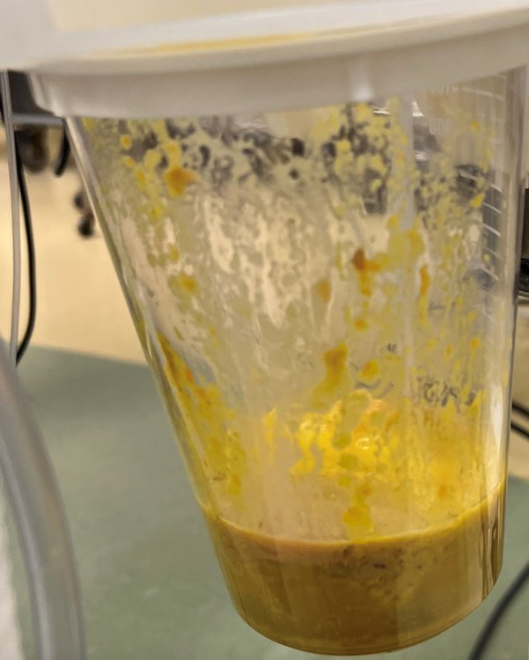
Theoretical Increased Risk of Aspiration with Anesthesia 2023
Quick response by American Society of Anesthesiologists
  “Guidance reflects concerns of delayed stomach emptying, which may cause patients undergoing anesthesia to experience aspiration, nausea and vomiting”
  “While . . . lack of scientific data . . anecdotal reports that the delay in stomach emptying could be associated with an increased risk of regurgitation . . . during general anesthesia and deep sedation”
    Hold daily GLP-1 agonists on the day of the procedure/surgery
    Hold GLP-1 agonists one week prior if taking weekly
      But . . up to five weeks for drug elimination

Slide 11
Theoretical Increased Risk of Aspiration with Anesthesia 2023
  Day of the procedure:
      Consider delaying if GI symptoms: severe nausea/vomiting/retching, abdominal bloating or abdominal pain and discuss concerns of potential risk of aspiration with the proceduralist or surgeon and the patient.
    Continue with the procedure if the patient has no GI symptoms and the GLP-1 agonist medications have been held as advised.
  If the patient has no GI symptoms, but the GLP-1 agonist medications were not held, use precautions based on the assumption the patient has a “full stomach” or
  Consider using ultrasound to evaluate the stomach contents. If the stomach is empty, proceed as usual. If the stomach is full or if the gastric ultrasound is inconclusive or not possible, consider delaying the procedure or proceed using full stomach precautions. Discuss the potential risk of regurgitation and aspiration of gastric contents with the proceduralist or surgeon and the patient.

Slide 12
2024 Multi-society Guidelines
American Society of Anesthesiologists, American Gastroenterological Association, American Society for Metabolic and Bariatric Surgery, International Society of Perioperative Care of Patients with Obesity, Society of American Gastrointestinal and Endoscopic Surgeons
Factors that may increase the risk of aspiration include:
  Escalation phase of dosing
  Long-acting GLP-1s, higher doses
  Presence of gastrointestinal symptoms of delayed gastric emptying (e.g., nausea, vomiting, and abdominal discomfort)
  Medical conditions other than GLP-1 usage that might delay gastric emptying
Selective preoperative care plan based on delayed gastric emptying assessment and shared decision-making:
  Continue GLP-1 therapy preoperatively if there is no concern for delayed gastric emptying
  If elevated risk of delayed gastric emptying: liquid only diet for at least 24 hour before procedure with usual recommended fasting protocol

Slide 13
2024 Guidelines
On the day of procedure, reassess for delayed gastric emptying and mitigate risk if clinical concern:
  Proceed with procedure as planned if there is no concern for delayed gastric emptying
  If elevated risk of delayed gastric emptying exists:
    Consider point-of-care gastric ultrasound and/or
    Consider rapid sequence induction of general anesthesia, if appropriate
    Minimize procedure cancellation when possible

Slide 14
Multiple Large Studies Showing NO Increase in Aspiration with GLP-1 drugs
Studies focused on significant aspiration with diagnosis of pneumonia and hospitalization or “residual gastric contents”
No consideration of micro-aspiration
Aspiration occurred even when the drug was stopped > 6 days before and fasting > 8 hours, underscoring the low absolute risk​
Large‑scale endoscopic data did not support a clinically meaningful rise in aspiration despite delayed emptying
> 4000 EGD procedures after GLP‑1, only two definite aspiration cases → 4.8 per 10 000 EGDs.​Historical Control: 4.6 per 10 000 EGDs in non‑GLP‑1 patients.​ Observed aspiration rate essentially identical to historical baseline, suggesting no added risk despite delayed emptying.​

Slide 15
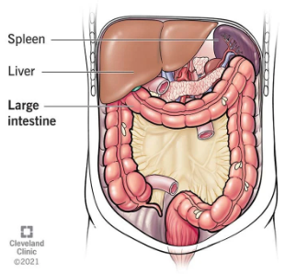
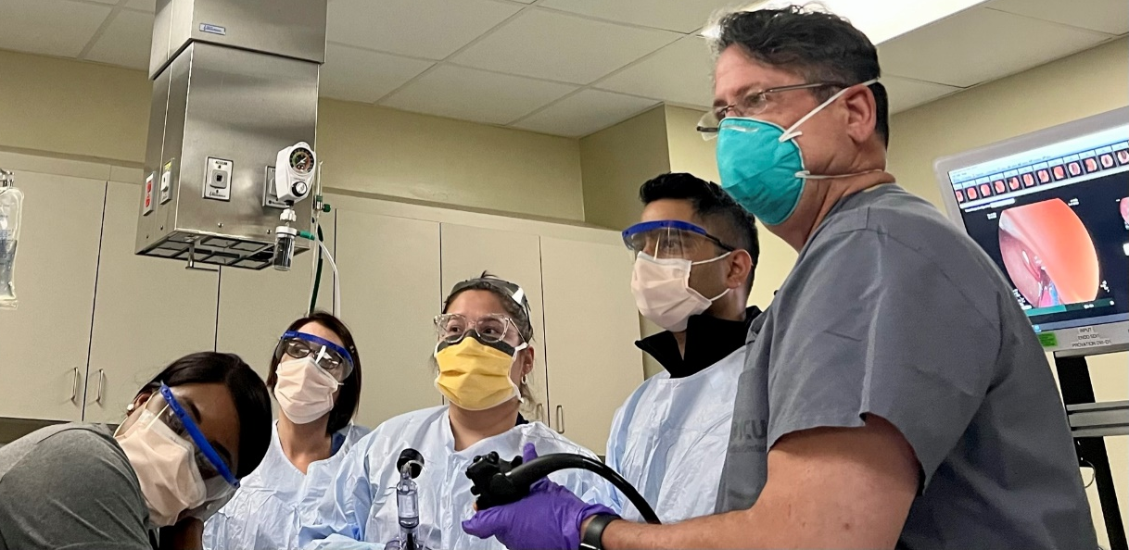
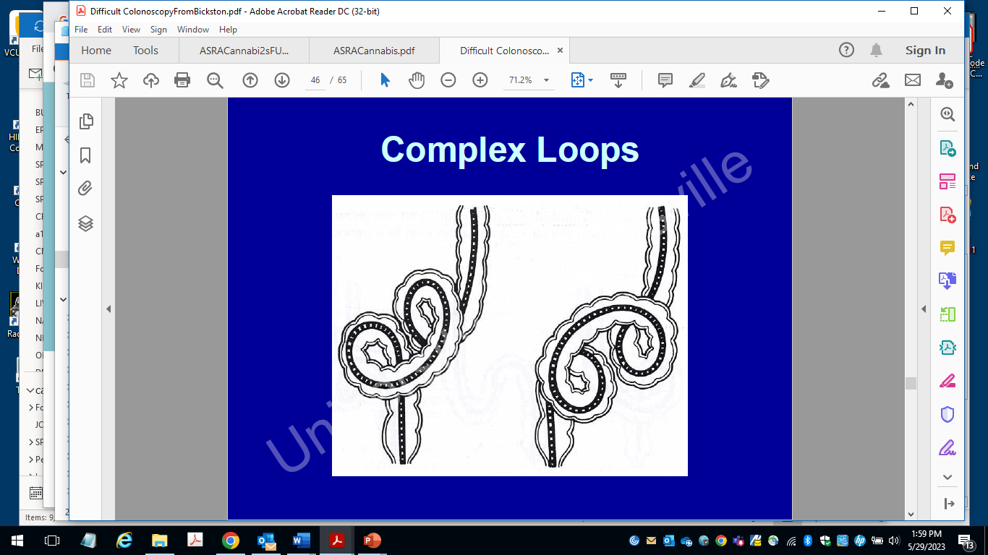
Who Aspirates and When/ Why?
On induction of anesthesia, lower esophageal sphincter relaxes, passive regurgitation
During bowel insufflation - vagal stimulation plus internal and external abdominal pressure
Vagal stimulation with reflex responses of salivation, coughing, swallowing and vomiting

Slide 16
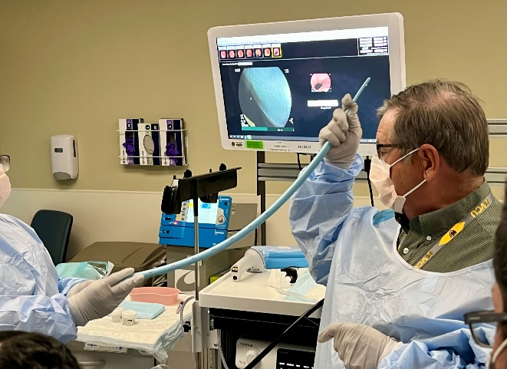
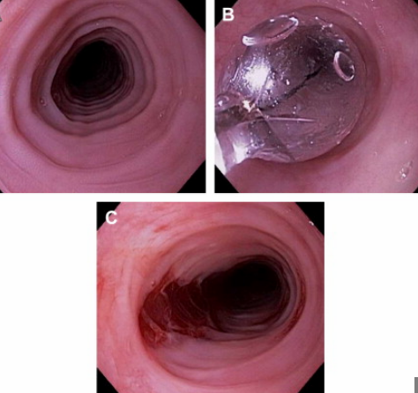
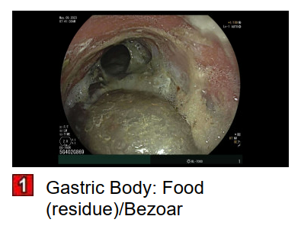
Who Aspirates and When/ Why?
Shared airway during upper endoscopy
Irritation of vocal cords with laryngospasm
Repeated passes near the vocal cords with scope, dilators
Stomach acid to throat with coughing , mini aspiration

Slide 17
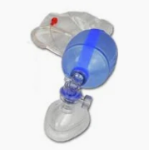
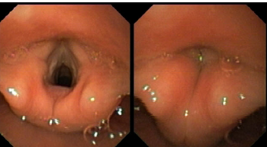

Who Aspirates and When/ Why?
Passive regurgitation from relaxed lower esophageal sphincter
  Begins with sudden coughing, abrupt fluid from mouth
Induced retching/vomiting from vagal stimulation or abdominal pressure
    Begins with retching, abdominal heaving, active vomiting
    Both scenarios lead to
    Laryngospasm
  Oxygen desaturation (to 70s or less)
Regurgitation/vomiting with coughing prompts increased oral/nasal secretions and further aspiration/irritation and copious secretions impairing ventilation
Is this really aspiration? YES.

Slide 18
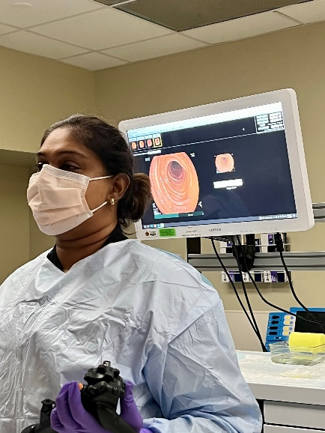
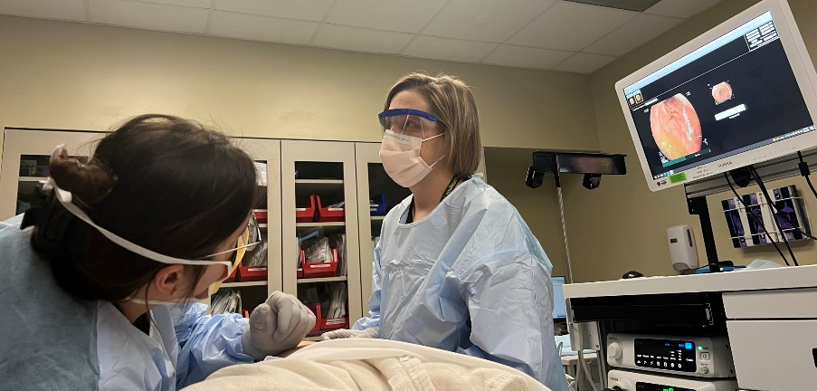
Who Aspirates and When/ Why?
Coughing, desaturation, wheezing often continues to PACU
Sore throat, excess secretions and phlegm below cords
Chest tightness, wheezing
Careful instructions to cough, deep breathe
Many will present to Urgent Care or ED and be diagnosed with aspiration pneumonia
Almost all mini-aspirations clear in 1-2 days, but
very annoying sore throat and cough

Slide 19
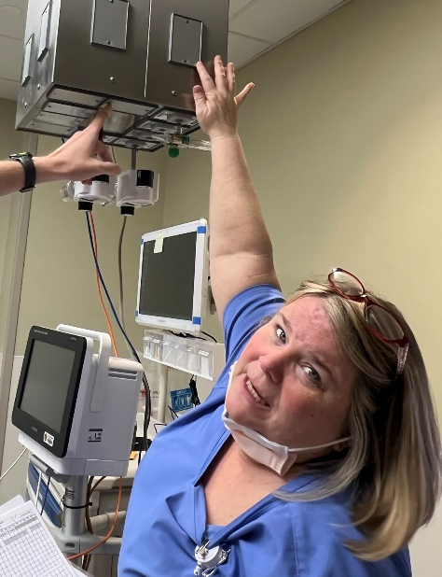
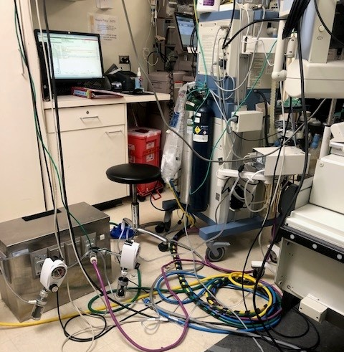
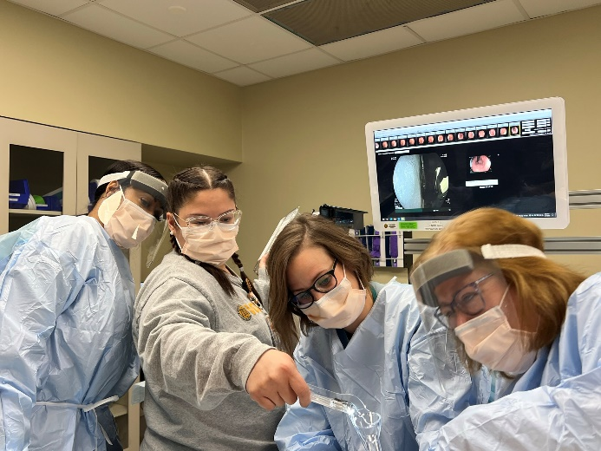
How can you help?
Situational awareness during sedation
Elevate head of the bed
Suction ready and on, help suction secretions
Ambu bag ready and connected to oxygen
In PACU - cough, deep breathe, follow sats
Reassurance to patient at post op call

Slide 20
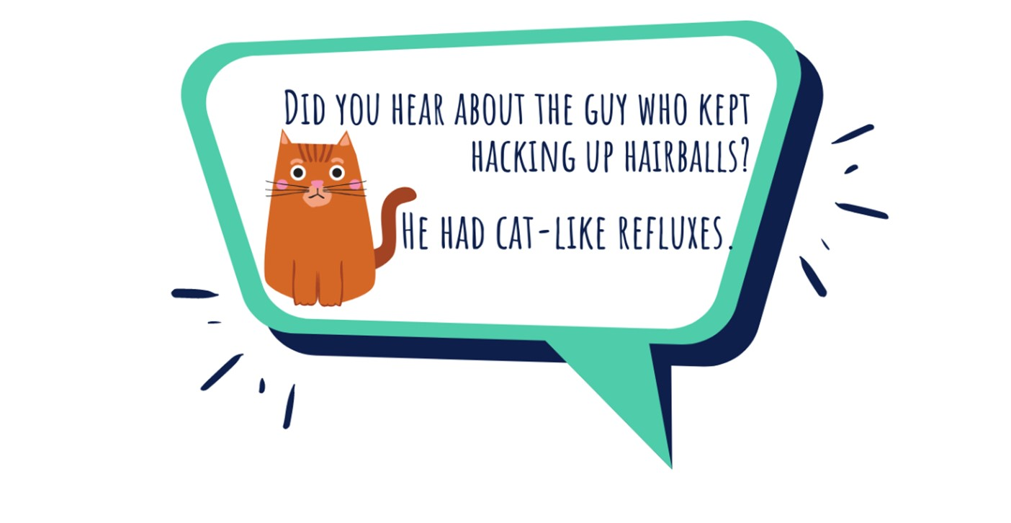

Slide 21


