Slide 1
Utilizing an Oncology Nurse Navigation Model to Improve Access to Colorectal Cancer Screening
Brandi Teel BSN, RN, OCN
Dakota Clemmons MSN, RN
Notes:
Hello. We are with the UVA Health Cancer Screening Program. Our program is new with the cancer center in the past 1.5 years. We would like to thank Irene Rader with the Mid Atlantic Society of Gastroenterology for inviting us to speak today. **Get Christi’s input**
I am Brandi Teel, BSN, RN, OCN
I am an oncology nurse with over 20 years' experience caring for patients through every stage of their cancer journey. I am a board certified OCN, and have specialized in chemotherapy/immunotherapy administration, symptom management, and patient education. Currently working to reduce barriers to cancer screening. I am passionate about delivering compassionate, evidence-based care and empowering patients and families with the knowledge and support they need.
I am Dakota Clemmons MSN, RN
I am an RN Care Coordinator with a background in ICU and Emergency/Trauma nursing and 10 years in oncology nursing, primarily specializing in women’s health and gynecologic cancers. I currently work in cancer screening, equipping patients and their families with knowledge and resources to empower them with choices that fit their diverse needs for cancer screening. I have a passion for bringing cancer screening to patients where they live, eliminating barriers to quality care.
Brandi:
Several months ago, it was brought to our team’s attention that there is a significant backlog in screening colonoscopy scheduling. Our team was brought in to assist the GI/endo team with facilitating colorectal cancer screening for patient’s of average risk. A quality improvement project was developed to utilize oncology nurse navigation to improve access to colorectal cancer screening through the use of stool based testing.

Slide 2
Disclosures
Dakota:
  No financial disclosures
Brandi:
  No financial disclosures
Notes:
We have no disclosures.

Slide 3
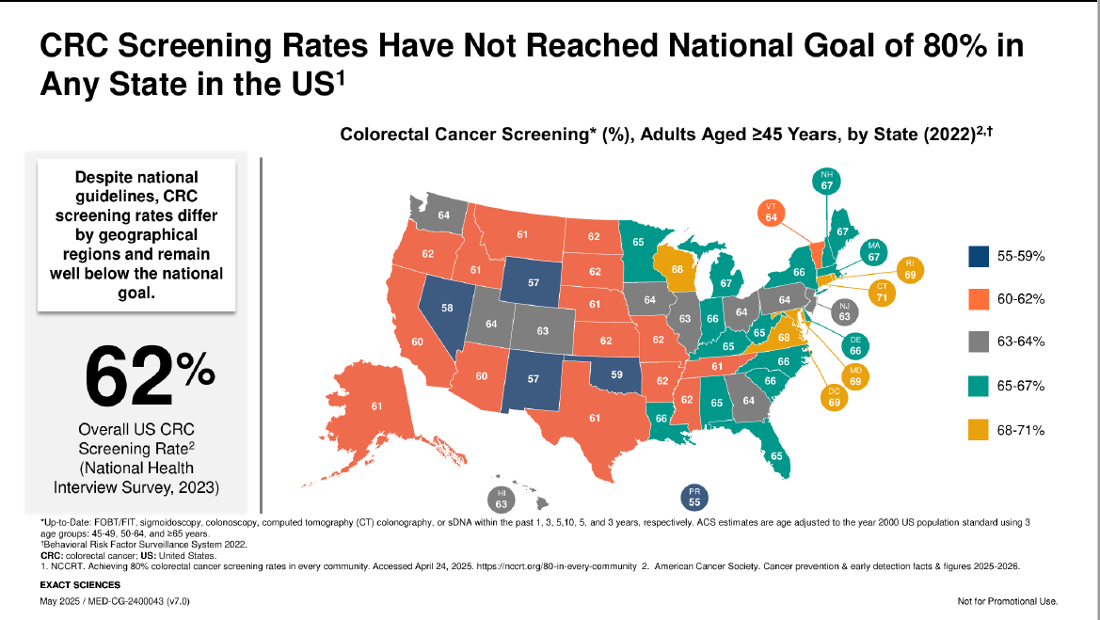
Notes:
Brandi: The national goal for colorectal cancer screening of 80% has not been reached in any state in the United States, and remains well below the national goal. According to the National Health Interview Survey of 2023, the overall US colorectal cancer screening rate is at 62%. Virginia averages between 68-71%. As you can see, we have a lot of work to do to nationally to improve colorectal cancer screening rates. It will take a multidisciplinary approach to achieve this goal.

Slide 4
How Did We Get Here?
Staffing shortages, provider availability, earlier recommended screening age, and facility capacity
59.2M eligible for CRC screening
Colonoscopy capacity 6.3M
Notes:
Dakota: 59.2 million patients are eligible for CRC screening. However, the colonoscopy capacity is only estimated to be 6.3 million annually, leaving millions of patients not screened and potentially undiagnosed. Based on this data from Exact Sciences, it is evident that colonoscopy should be reserved for high risk patients and those patients with a positive stool test.
Brandi: In 2018, the American Cancer Society recommended reducing the colorectal cancer screening age from 50 to age 45. This was officially adopted by the United States Preventative Services Task Force in May 2021. This reduced screening age has placed even further burden on health systems with limited colonoscopy capacity.
Dakota: Staffing shortages, provider availability, earlier recommended screening age, and facility capacity have led to national backlogs in endoscopy, causing patients needing colorectal cancer screening to be waitlisted for 12 to 18 months or longer.

Slide 5
Patient Perspective
Competing priorities
Fear Factor
Cost concerns
Wait time
Notes:
Brandi:
We know from the previous slide that there are millions of eligible patients who need colorectal cancer screening. In addition to health system barriers, there are also patient barriers that need to be overcome in order to improve screening rates. One of these barriers is competing priorities. A Colorectal Cancer Alliance poll showed that despite provider recommendations, 72% of adults state that everyday life gets in the way of completing colorectal cancer screening. Unfortunately, with the busyness of life, cancer screenings often get placed on the back burner, especially with the preparations needed for colonoscopies.
Dakota:
Fear is another barrier patients face. In the same poll from the Colorectal Cancer Alliance, over 1/3 of the patients states they hadn’t gotten screened due to fear of positive results. This barrier can be overcome with guidance and reassurance from healthcare professionals, specifically navigators who can help to assure that patients will be followed and supported through the care continuum from screening through diagnosis if needed.
Cost concerns are another barrier for patients. Insurance coverage and financial assistance concerns are barriers to patients getting colorectal cancer screenings. 62% of patients state that they would get colorectal cancer screening if they knew that insurance would cover it at no cost.
In addition, wait times from time of screening referral to scheduling (12+ months) has resulted in patients hesitancy to proceed with screening. Since starting our work with the cancer screening program, we have experienced this first hand through patient comments such as these: “I thought you all forgot about me.” “If it was not important to schedule and year ago, then I don’t need to schedule it now.”
Brandi:
Healthcare system barriers and patient concerns can result in delayed screening which can have a negative impact for patients.

Slide 6
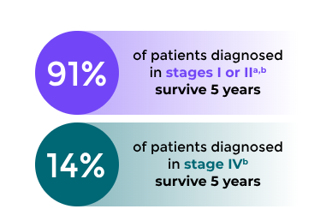
Impact of Delayed Screening
Increased mortality
Late stage diagnosis
Notes:
Brandi: According to the American Cancer Society, colorectal cancer is the 3rd most common type of cancer in the US and the 2nd leading cause of cancer death in the US among both men and women. In adults under 50, colorectal cancer is the 1st leading cause of death in men and 2nd in women. Colorectal cancer screening is imperative to early detection and treatment. When colorectal cancer is detected in early stages, the 5 year survival rate improves to 91% compared to only 14% when detected at stage IV. Screening results in a 25.5% reduction in cancer incidence and a 54.2% reduction in cancer mortality. A quality improvement study published in the Clinical and Translational Gastroenterology journal showed a prediction model indicating that delays in screening colonoscopy past 4-6 months had a higher incidence of advanced stage colorectal cancer and a higher mortality rate was shown in cases where delays were greater than 12 months. To improve screening rates, national, state and local organizations are available to provide resources to patients and healthcare providers with the goal of improving access to screening.

Slide 7
National Resources
American Cancer Society
Centers for Disease Control and Prevention
National Cancer Institute
Prevent Cancer Foundation
Colorectal Cancer Alliance
Notes:
Brandi:
National resources include:
American Cancer Society: Provides information for patients, caregivers, and healthcare professional on prevention, screening and treatment.
Centers for Disease Control and Prevention (CDC): Offers a comprehensive overview for colorectal cancer, including screening guidelines for people aged 45 and older
National Cancer Institute: A government resource for in-depth information on treatment, clinical trials, genetics, and research for colorectal cancer
Prevent Cancer Foundation: focuses on the prevention and early detection of cancer through education and research
Colorectal Cancer Alliance: This national organization offers a toll-free helpline and financial assistance for screenings, particularly for low-income and uninsured individuals
Due to lapse of government funding, some information on the government websites is only current as of early 2025.

Slide 8

State and Local Resources
Hitting Cancer Below the Belt (HCB2)
Virginia Colorectal Cancer Roundtable (VCCRT)
Virginia Association of Free and Charitable Clinics
UVA Health Emily Couric Comprehensive Cancer Center
This Photo by Unknown Author is licensed under CC BY-NC-ND
Notes:
Dakota:
Hitting Cancer Below the Bely (HCB2): Virginia-based nonprofit works to increase access to colorectal cancer screenings. It provides support to community health centers and clinics that serve low-income and underserved populations
Virginia Colorectal Cancer Roundtable (VCCRT): This coalition advocates for and works to increase colorectal cancer screening rates across Virginia. It provides up-to-date information on state guidelines and insurance coverage, including changes for 2025 regarding no-cost coverage for follow-up colonoscopies after positive at-home tests.
Virginia Association of Free and Charitable Clinics: This association can help low-income and uninsured patients find a local clinic for a medical home and access to screening services
UVA Health Emily Couric Comprehensive Cancer Center: The UVA Health Emily Couric Comprehensive Cancer Center and UVA Digestive Health Center provide a full range of colorectal cancer screening options for insured individuals, including colonoscopies, FIT, and Cologuard.

Slide 9
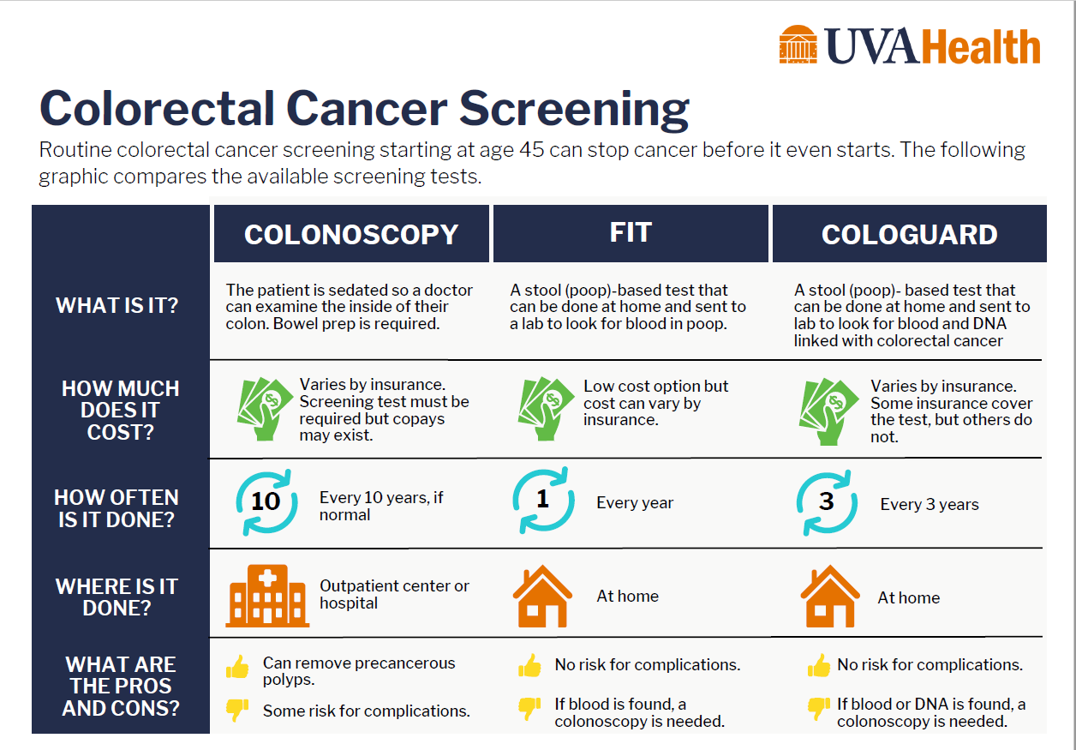
Patient Options
Notes:
Brandi:
At UVA Health, this colorectal cancer screening card was created as a quick reference sheet/card and is utilized in our primary care clinics. This allows our patients to review their colorectal cancer screening options and initiate a conversation regarding screening with their provider during their appointment. These sheets are available in the patient rooms at the primary clinics as well as cards for patients to take home to review.
Brandi:
Colonoscopy:
Colonoscopy requires prep, sedation, and travel to an outpatient center or hospital. Patient must also be accompanied to the appointment. Insurance coverage varies and copays may exist. Testing is recommended every 10 years if negative. Colonoscopy can remove precancerous polyps but has risk of complications due to invasive nature of the procedure.
Stool based testing is a good option for patients of average risk. This excludes patients with personal or family history (first degree relative: parent, sibling, child) of colorectal cancer, hereditary CRC syndromes, inflammatory bowel disease, positive result for Cologuard test in the past, active rectal bleeding, abdominal or pelvic radiation for prior cancer or abnormal prior colonoscopy. The two stool based testing options are FIT testing and Cologuard testing.
Dakota:
FIT:
FIT testing is a stool based test, done at home, no prep required. This test looks for blood in the stool. It is a low cost options but requires annual retesting. There is no risk for complications and if blood is found in the stool, diagnostic colonoscopy is recommended.
Cologuard:
Cologuard is a stool based test, done at home, no prep required. This test look for blood and DNA in the stool. Coverage varies by insurance. Cologuard testing is recommended every 3 years, if negative. There is no risk for complications and if blood or DNA is found, a diagnostic colonoscopy is recommended.

Slide 10
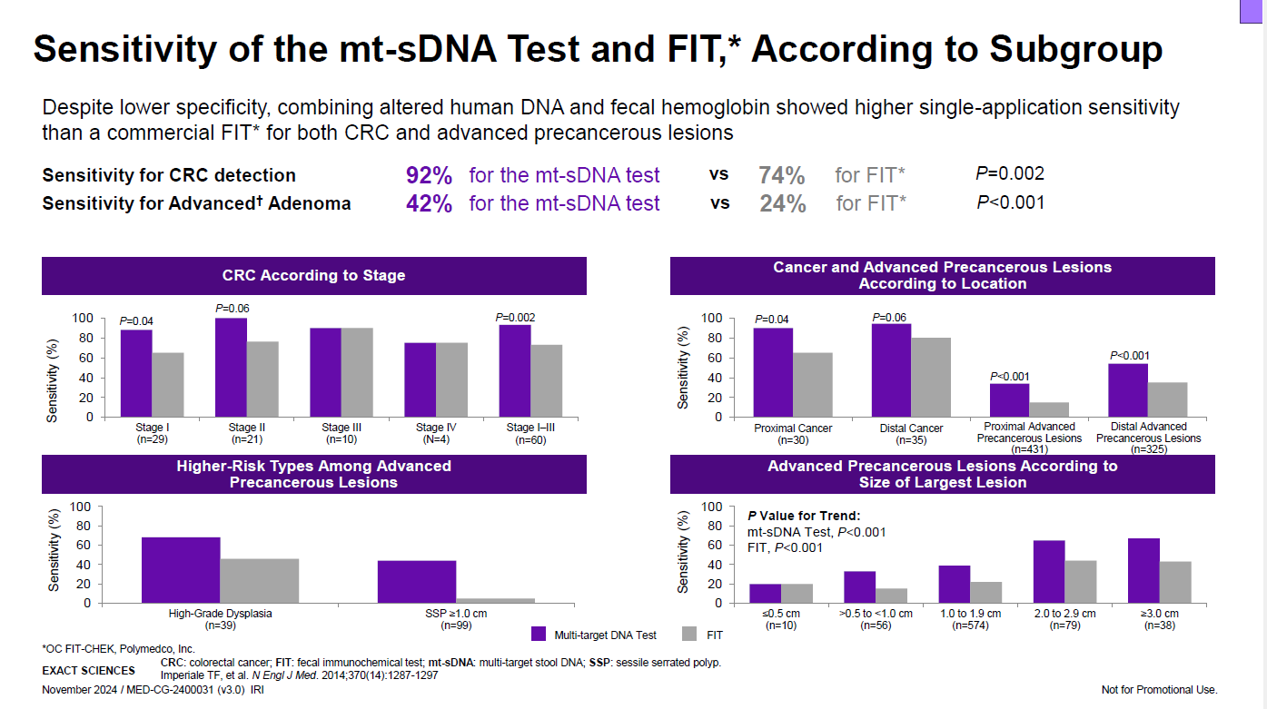
Cologuard vs. FIT
Notes:
Dakota:
Our screening program utilizes FIT and Cologuard as stool based testing options.
In research published in the New England Journal of Medicine, compared side by side, FIT has 74% sensitivity for colorectal cancer detection while Cologuard has 92% sensitivity. In the detection of advanced adenoma, Cologuard showed a 42% sensitivity compared to a 24% sensitivity with FIT testing.

Slide 11
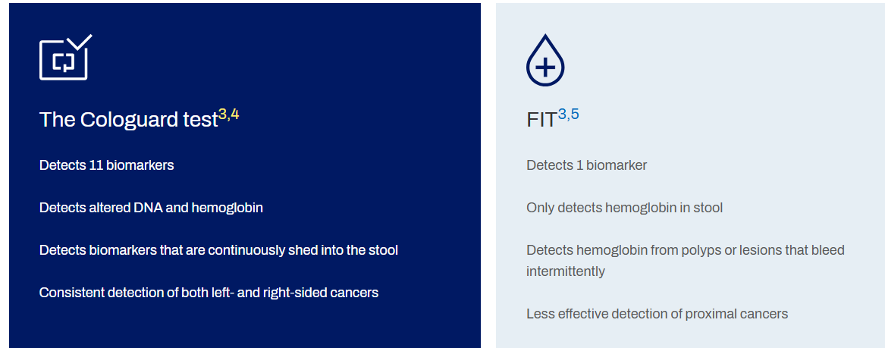
Notes:
Dakota:
The higher sensitivity of the Cologuard test makes it the preferred option for stool based colorectal cancer screening. Cologuard detects 11 different biomarkers while FIT detects 1 biomarker. FIT looks for blood in the stool only while Cologuard detects altered DNA along with blood in the stool. FIT detects hemoglobin from polyps or lesions that bleed intermittently while Cologuard detects biomarkers that are continuously shed into the stool. FIT is less effective in the detection of proximal cancers compared to Cologuard which has been consistent in detection of left and right sided cancers.

Slide 12

Now What?
This Photo by Unknown Author is licensed under CC BY-SA-NC
Notes:
Brandi: No one person or team can fix this issue. In response to increased demand for screening colonoscopy at UVA Health, the Cancer Center has been entrusted with the work of improving access to cancer screening. However, colorectal cancer screening impacts many areas of the healthcare system to include GI/endoscopy and primary care, where screening is initiated. By collaborating with team members in all of these areas, we explored the development of a clinical pathway to reduce appointment wait times and offer appropriate alternative screening options for patients of average risk. A clinical pathway was implemented, incorporating oncology nurse navigation, with the goal of improving access to timely colorectal cancer screening.

Slide 13
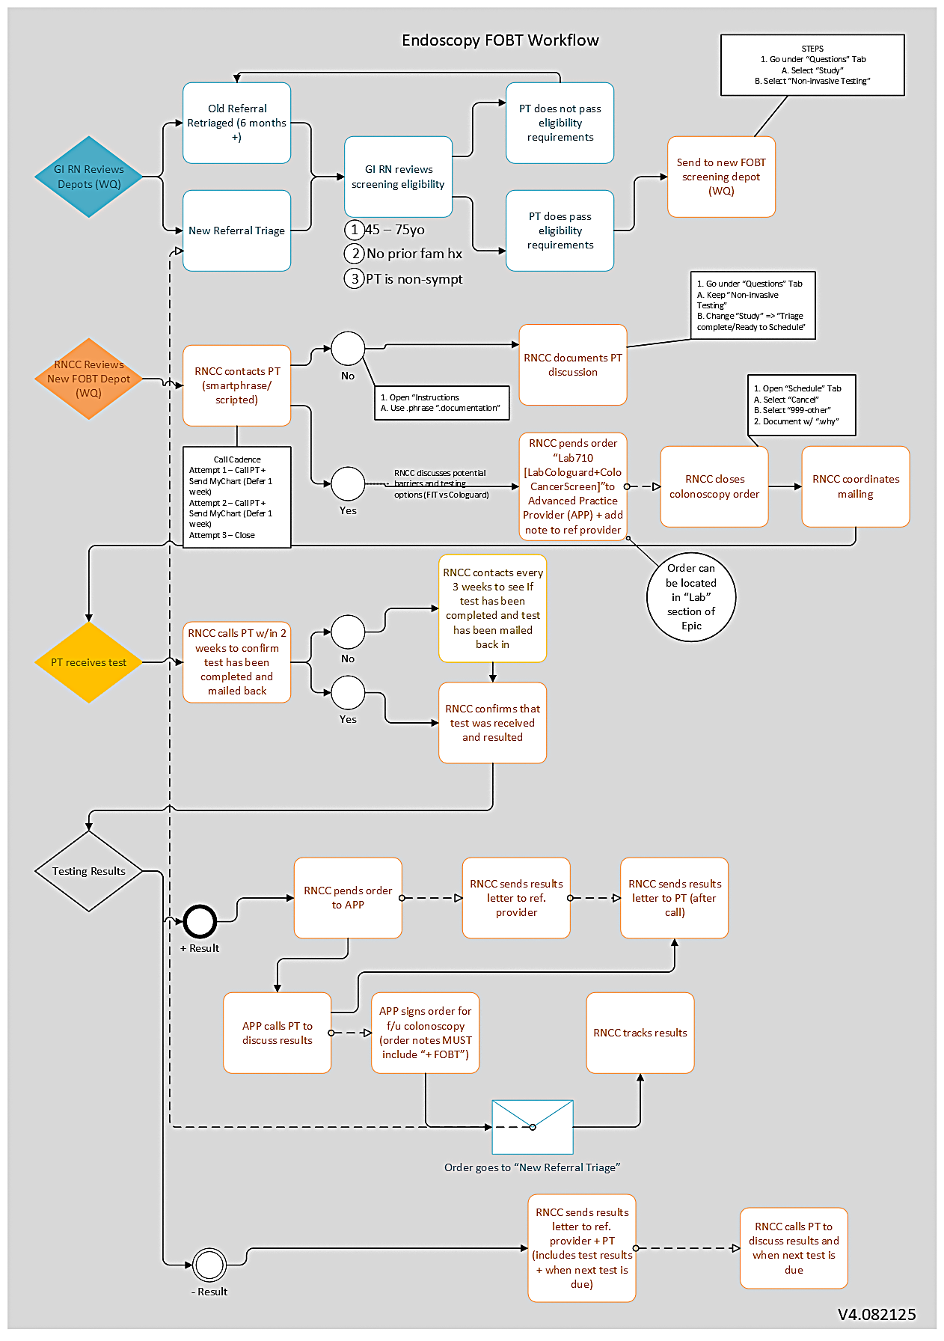

This Photo by Unknown Author is licensed under CC BY-SA-NC
Notes:
Brandi:
A multidisciplinary workgroup was formed, including GI/endo nurses, gastroenterologists, cancer screening RNCCs, dedicated cancer screening APP, project coordinators, and directors. This team collaborated to create a clinical pathway aligned with the electronic medical record. The electronic medical record at UVA Health is Epic. The pathway was designed to triage patients to an appropriate screening modality, beginning with internal patients who had been waiting the longest for screening colonoscopy. The workgroup established role delineation, developed patient-facing scripting, developed a depot for eligible patient referrals, and created a process to identify patients and track results. Prior to inhiation, this process change was introduced to the medical directors for the primary clinics. Oncology nurse navigators contacted patients to provide education about screening options, initiated the patient-selected screening modality, tracked results, and then reported the results to the referring provider and the patient. For patients with positive screening results, the nurse navigators expedited diagnostic testing and facilitated the transition to cancer care when needed.
As seen on the slide, a workflow was developed and approved by the multidisciplinary team. The GI/Endo nurses review the colonoscopy referrals to determine if patient is eligible for stool based testing. If patient is not eligible, the GI nurses will schedule the patient for colonoscopy. If the patient is eligible for stool based testing, the GI nurses will send referral to the stool based testing screening depot. The cancer screening RNCC contacts patients in this depot, offering them stool based testing as an alternative to colonoscopy. If patients decline stool based testing, the RNCC documents the patient discussion and returns the referral back to the GI nurse for colonoscopy scheduling. If the patient does accept stool based testing, the cancer screening RNCC closes the colonoscopy order and pends order to dedicated cancer screening APP, offloading this from the referring provider. RNCC follows up with the patient to confirm that the kit has been received and to assess for any barriers to completion of the kit. Once the kit has been returned, the RNCC tracks the results. If results are negative, the RNCC sends results letter to referring provider and the patient. This letter includes the results and when the next test is due. The RNCC calls the patient to discuss results and next testing date. If the results are positive, the RNCC pends diagnostic colonoscopy order to the cancer screening APP. The cancer screening APP calls the patient to discuss results and next steps. Once the patient is notified of the positive results, the RNCC sends a results letter to patient and referring provider. The RNCC continues to track the patient for a cancer diagnosis and navigational needs.

Slide 14
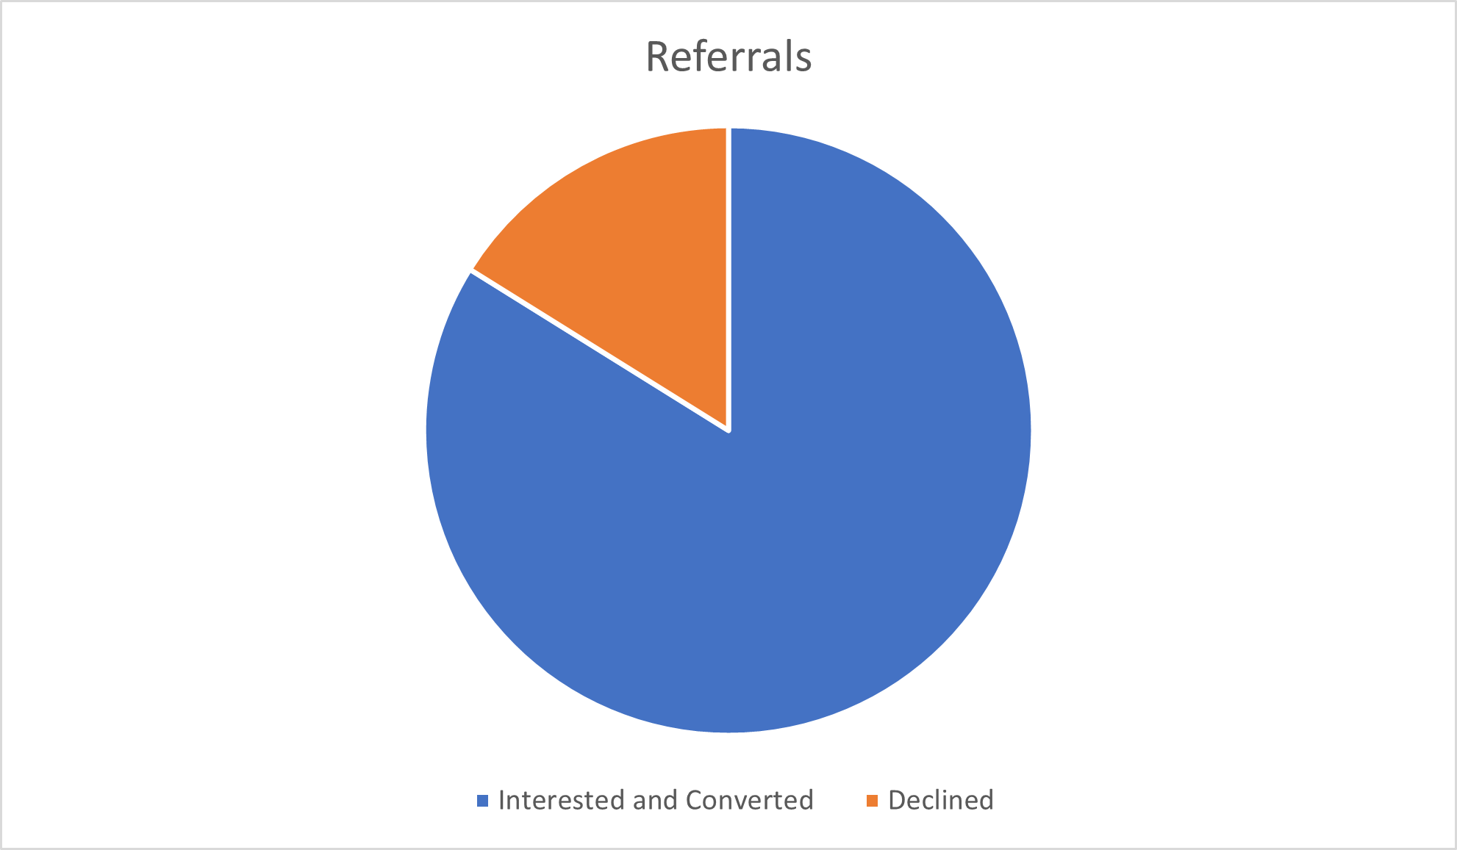
Results
Notes:
Dakota:
The clinical pathway was developed and initiated in March 2025 and remains in active implementation. These graphs are reflective of data from March 2025-September 2025.
The total number of referrals for that time frame was 384.
External provider referrals totaled 34 and were excluded from the data.
In addition, 21 patients were inappropriate referrals to the screening depot, meaning they were ineligible for various reasons.
Also, 50 patients were unable to be reached and therefore excluded from this data as well.
This left a referral count of 279. The blue portion of the pie chart shows that 234 patients, or 84%, were interested in stool based testing and had colonoscopy orders converted to either Cologuard or FIT testing.
The orange portion of the pie chart shows that 45 patients, 16%, declined stool based testing.
Results of the patients whose orders were converted to stool based testing are shown on bar graph. Twenty percent were negative, 1% were positive, and 79% have not completed their stool based testing as of September 2025. Of the 1% that were positive, diagnostic colonoscopies have been completed within 3 months of positive stool based testing result. Cancer screening RNCC continue to monitor and contact patients based on workflow cadence to ensure patients complete testing.

Slide 15
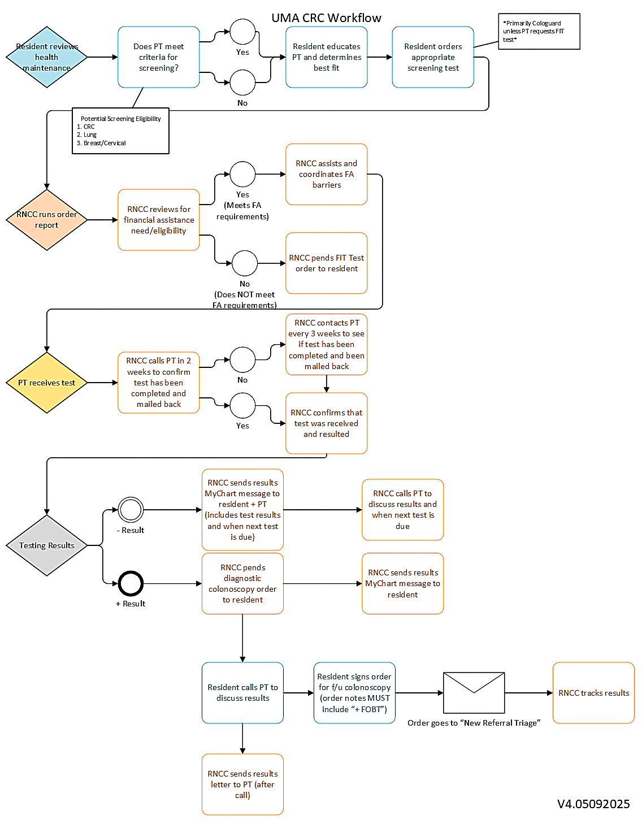
University Medical Associates
Notes:
Dakota:
The GI/Endoscopy workflow was modified in order to be replicated for the UMA clinic. At the UMA clinic, there are residents who review the health maintenance for a patient to determine eligibility for colorectal cancer screening. If patients are eligible, they place the order for the appropriate screening test. Once the orders have been placed, the RNCC runs the order report generated by Epic data fields and reviews financial assistance needs/eligibility as needed. This process includes navigating patients to the appropriate financial assistance program. The RNCC contacts the patient 2 weeks after the order has been placed to ensure patient receipt and completion of test kit. If the test kit has not been received, RNCC coordinates mailing. If the patient has not completed the test at 2 weeks, they are contacted every 3 weeks until test has been completed. If testing is negative, the RNCC sends results via MyChart message to the resident and the patient. This message includes the results and next testing date. The RNCC also calls the patient to discuss results and next testing date. If the results are positive, the RNCC pends a diagnostic colonoscopy order to the resident and sends a MyChart message to the resident. The resident calls the patient to discuss results and signs the diagnostic colonoscopy order. The order then goes to the GI/Endo team for scheduling and the RNCC tracks scheduling progress and colonoscopy results. If colonoscopy results are positive for cancer, the RNCC navigates the patient to appropriate cancer care based on patient preferences.

Slide 16
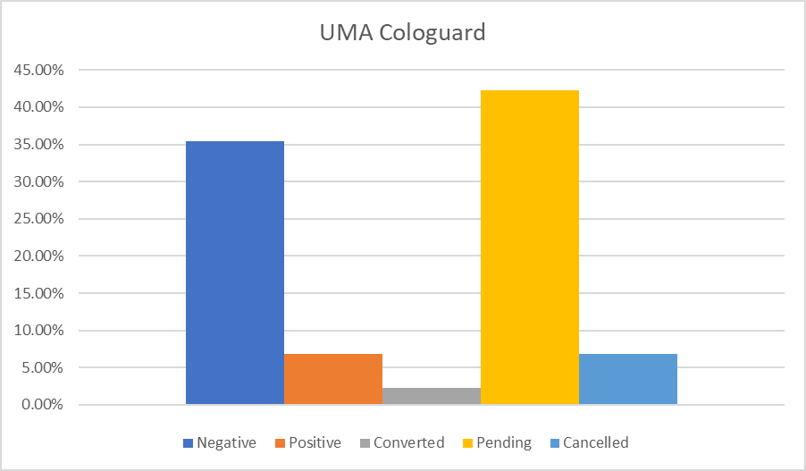
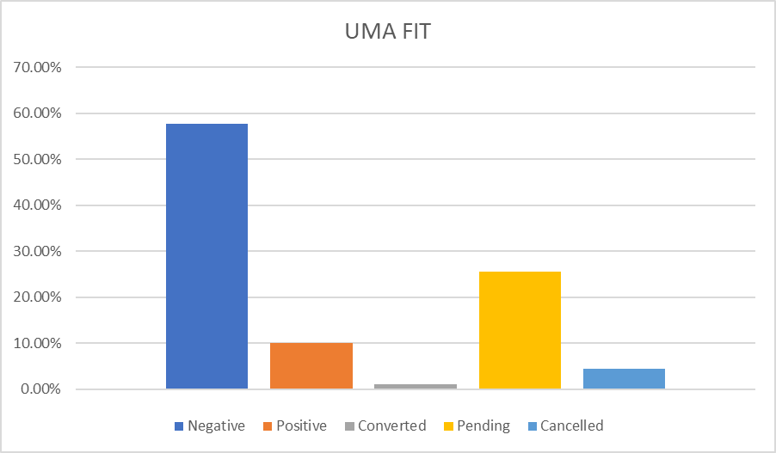
Results
Notes:
Brandi:
The workflow for UMA began in May 2025. This data is reflective of May 2025-September 2025.
Cologuard:
There were 305 total test ordered.
35.4% were negative
6.8% were positive
2.3% were converted to FIT
42.3% are pending
6.8% are not appropriate/cancelled
FIT:
There were 90 total tests ordered
57.7% were negative
10% were positive
1.1% were converted to Cologuard
25.5% are pending
4.4 % are not appropriate/cancelled
For the 16.8% of patients with a positive stool based test, diagnostic colonoscopies were scheduled within 3 months of the positive stool test, unless patients have preferred a different scheduling date.

Slide 17
Conclusions
Clinical pathway developed
Improved access to colorectal cancer screening
Decreased wait times for high risk patients needing colonoscopies
Removed barriers related to stool based testing
Expedited diagnostic testing and transition to cancer care when needed
Notes:
Brandi:
This QI project focused on increasing access to colorectal cancer screening by developing and implementing a clinical pathway. The pathway defines team members roles, call cadences, outreach timelines, and reporting processes. Although the project is ongoing, initial results demonstrate improved access to colorectal cancer screening. This process has been adapted in primary clinics across the system with similar results, as shown in the UMA data that was presented. Patients and referring providers have responded positively, and plans are underway to expand the model to include screening colonoscopy referrals from external providers.
Dakota:
Through development of this clinical pathway, high risk patients experienced shorter wait times for necessary colonoscopies. Barriers related to stool based testing were removed. Expedited diagnostic testing times improved for those with positive stool based testing, and transition to cancer care was provided when needed. Dr. Corley, who is the lead investigator for the colon cancer component of Population-based Research to Optimize the Screening Process (PROSPR), stressed the effectiveness of colorectal cancer screening. “One study we published showed that by increasing screening rates from 40% to 80%, we could cut the incidence of colorectal cancer deaths in half,” he said. “[This] raises the importance of being able to get the individual steps correct and completed as best you can ... because every step where you lose some people in follow-up can have a big impact.” It takes collaboration among all team members throughout the healthcare continuum to ensure that patients receive equitable access to timely colorectal cancer screening.

Slide 18
References
American Cancer Society. (2018, May 30). Colorectal Cancer Screening Guideline Issue Brief. Colorectal Cancer Screening Guideline Issue Brief . Retrieved October 22, 2025, from https://nccrt.org/wp-content/uploads/2024/03/CRC-Screening-Guidelines-for-Average-Risk-Issue-Breif_FINAL.pdf.
Ben-Ari, E. (2022, March 5). Follow-up colonoscopy after positive fit test. Follow-Up Colonoscopy after Positive FIT Test - NCI. https://www.cancer.gov/news-events/cancer-currents-blog/2022/positive-fit-stool-test-colonoscopy
Colorectal cancer statistics: How common is colorectal cancer?. Colorectal Cancer Statistics | How Common Is Colorectal Cancer? | American Cancer Society. (n.d.). https://www.cancer.org/cancer/types/colon-rectal-cancer/about/key-statistics.html
Exact Sciences. (2025). Cologuard PlusTM test vs fit: A more accurate CRC screening option. THE COLOGUARD TEST VS FIT. https://www.cologuardhcp.com/about/cologuard-vs-fit?utm_medium=cpc&utm_source=google&utm_campaign=FY25_ES_COLOGUARD_HCP_NONBRAND-EVAL-P_017_X_X_EVA_GOOG_NON_PHS&utm_id=18599067314&utm_term=fit+colorectal+cancer+screening&utm_content=141664654239&gad_source=1&gad_campaignid=18599067314&gclid=EAIaIQobChMI7cW31-u6kAMVAXRHAR1EfiiLEAAYASAAEgIUPvD_BwE
Exact Sciences. (2024, November) Colorectal Cancer (CRC) Screening and the mt-sDNA (Cologuard) Test. [PowerPoint Slides].
Impact of delayed screening. Exact Sciences. (n.d.-a). https://www.exactsciences.com/exactacademy/colorectal-cancer-screening/impact-of-delayed-screening
Imperiale TF, et al. N Engl J Med. 2014;370(14):1287
Mortality. Exact Sciences. (n.d.). https://www.exactsciences.com/exactacademy/colorectal-cancer/epidemiology/mortality
Shim, H., Gupta, A., Fu, A., Flores, R., Simmons, R., Steinberg, J., Guerson-Gil, A., Liao, Y., Yang, J., LaComb, J. F., D’Souza, L. S., Monzur, F., Li, E., & Guillaume, A. (2024). A Quality Improvement Study on Colonoscopy Wait Times in Underinsured Patients Following the COVID-19 Pandemic. Clinical and Translational Gastroenterology, 15(9). https://doi.org/10.14309/ctg.0000000000000730
US Preventive Services Taskforce. (2021, May 18). Colorectal cancer: Screening. Recommendation: Colorectal Cancer: Screening | United States Preventive Services Taskforce. https://www.uspreventiveservicestaskforce.org/uspstf/recommendation/colorectal-cancer-screening
Wakefield Research. (2025, February). Majority of Americans Think They Don’t Have Time for Colorectal Cancer Screening, As They Prioritize Household Chores. Www.Colorectalcancer.Org. Retrieved October 24, 2025, from https://colorectalcancer.org/sites/default/files/media/documents/1%20Wakefield%20Research%20CRC%20Screening%20Survey%20Summary%20%281%29-Nicole%20Edit.pdf.

Slide 19

Questions

