Slide 2
Patient Navigation For Open Access Endoscopy
The Role of the Endoscopy Triage Nurse
Cindy Gentry, RN, BSN, CGRN

Slide 3
Definition of Open Access Endoscopy
Open access endoscopy (OAE) is defined as the performance of endoscopic procedures requested by referring physicians without a prior clinic consultation. (Open Access Endoscopy (Chandrasekhara et al., 2015).
Traditionally, physicians have requested consultations for their patients by a GI endoscopist to determine whether endoscopic intervention was indicated. (Open Access Endoscopy (Chandrasekhara et al., 2015).

Slide 4
The Role Of The OA GI Triage Nurse
To evaluate open access endoscopy referrals to determine urgency and appropriateness for procedures
To make sure that those in most critical need of an endoscopic procedure receive timely care
To ensure that the patient is having their surveillance exams/ follow-up procedures done on time
To ensure the endoscopy unit's workflow is optimized and cases can proceed efficiently.

Slide 5

Key Steps In Triaging
Reviewing patient referrals
Gathering patient history
Assessing urgency
Making adjustments
Optimizing resource utilization

Slide 6
Reviewing Referrals
This is the most important step of the whole navigation process.
This step allows you to determine if the referral is appropriate for endoscopy and to determine if the patient needs to be referred to an interventionalist, GI clinic, or colorectal surgery.
The review ensures that only suitable candidates are scheduled for open-access slots

Slide 7

Mollie James/ Future Olympian

Slide 8
Gathering Patient Medical History
Data collection– such as collecting previous endoscopy records, Detailed medical history: height, weight, allergies, PMH, PSH
Comorbidities: The nurse reviews the patient's medical history for conditions that may complicate the procedure, such as cardiopulmonary disease, sleep apnea, or a history of adverse reactions to sedation.

Slide 9
Assessing Urgency
Determine indication
Determine urgency
Determine if we can safely scope the patient
Identify and manage health risks that could affect patient safety or medication effectiveness.
Reduce complications during and after endoscopy.

Slide 10
Making Adjustments On The Referral
Adjustments are made based on guidelines and patient assessment – determine if patient is due U.S. Multi‑Society Task Force on Colorectal Cancer. Colorectal cancer screening: Recommendations for physicians and patients from the U.S. Multi‑Society Task Force on Colorectal Cancer. American Society for Gastrointestinal Endoscopy, 2020.
Cancel procedure if not due/ send letter to referring
Send to clinic for a pre-procedure evaluation prior to scheduling

Slide 11
Multi-Society Task Force
Multi Society task force is a collaborative body of gastroenterology societies that develops consensus-based guidelines on endoscopy best practices, such as screening recommendations, endoscopic polyp removal, and colonoscopy quality metrics like bowel preparation and adenoma detection. This task force, composed of representatives from organizations like the American College of Gastroenterology and the American Society for Gastrointestinal Endoscopy, aims to improve patient care and digestive health by providing evidence-based guidance on key issues in gastrointestinal endoscopy. U.S. Multi‑Society Task Force on Colorectal Cancer. Colorectal cancer screening: Recommendations for physicians and patients from the U.S. Multi‑Society Task Force on Colorectal Cancer. American Society for Gastrointestinal Endoscopy, 2020.

Slide 12

Scout – Also Another Future Olympian

Slide 13
Documentation
Case request – this is how the referral information/order is received and communicated to the triage team
Triage nurses transfer the information from the external referral to the electronic medical records
Triage note- contains key information that is communicated to the endoscopist about the reason for the procedure, medical hx, anesthesia hx/ information
This is especially important in our open access referrals.

Slide 14
Optimizing Resource Utilization
Consult with the GI provider assigned to assist with the triaging team
Consult with anesthesia to see if patient can safely be sedated.

Slide 15
Example Of A Triage Note For Open Access
Sample of our triage note / drop down menu
11/15/2025 Open Access Endoscopy/Colonoscopy Triage Note:
Procedure: {krproced:23904} Colonoscopy, EGD, Flexible Sigmoidoscopy
Indications: {Indications}- screening, surveillance, high risk, diagnostic, IBD + FIT/ Cologuard
Location: {Location of Procedure:22846}
Other Notes: Medical Information
Referring Provider: ***
Prior Endoscopy/Colonoscopy: ***
Triage Nurse: ***
The patient record has been reviewed and triaged by an Endoscopy Coordinator.

Slide 16


Otis- Our Fishermen And Baseball Player

Slide 17
Support Teams
Anesthesia team – dedicated team
Pre operative anesthesia clinic- hospital wide clinic
GI providers- assigned providers that are available daily
Other team members- our co workers that are on the triage team

Slide 18
Endoscopy Prep Team
Confirming procedure details: The nurse verifies the specific endoscopic procedure ordered and confirms that the patient understands the indication.
Bowel preparation: For colonoscopies, the nurse ensures the patient understands and is capable of completing the bowel preparation process. Non-adherence is a common reason for cancellation or poor outcomes
NPO status: The nurse reinforces the "nothing by mouth" (NPO) instructions, a critical safety measure to prevent aspiration during sedation.

Slide 19
Work In Partnership
Colorectal Surgery
General Surgery
GI Interventional team
Cologuard CRC Screening Team (Cancer Center – Screenings)

Slide 20
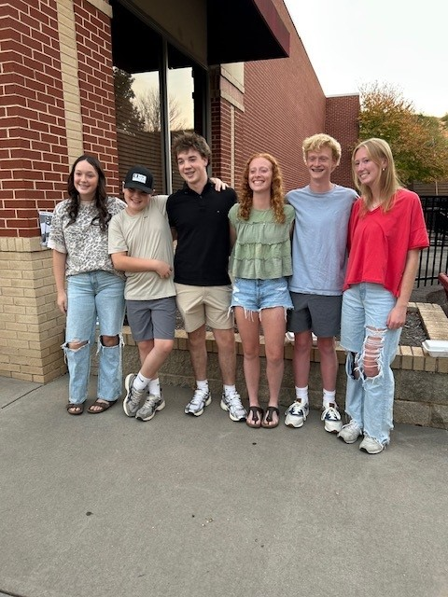
Some Of Our Older Grandchildren

Slide 21
IS OAE SUCCESSFUL?
OAE is commonly used and has been successful. The majority of patients referred for OAE are considered appropriate for endoscopy according to ASGE guidelines. Open Access Endoscopy (Chandrasekhara et al., 2015).

Slide 22
Benefits Of Open Access Endoscopy Triage
Increased safety: By identifying potential complications and adjusting the care plan in advance, the nurse review reduces risks associated with sedation and underlying medical conditions(Open Access Endoscopy (Chandrasekhara et al., 2015).
Improved efficiency: Proactive screening reduces procedure delays and cancellations on the day of the endoscopy, optimizing the unit's workflow. (Open Access Endoscopy (Chandrasekhara et al., 2015).
Resource optimization: The review helps triage patient referrals, ensuring that only suitable candidates are scheduled for open-access slots, which in turn frees up resources for more complex cases. (Open Access Endoscopy (Chandrasekhara et al., 2015).

Slide 23
Takeaways From The Article:
Most patients undergoing OAE procedures are knowledgeable about the study and are satisfied with the experience.
Several potential problems have been identified, including inappropriate referrals, communication errors, and inadequately prepared or informed patients.
OAE can be safely used if pre-procedure assessment, informed consent, information transfer, patient safety, and satisfaction are addressed in all cases.

Slide 24


Eislee – The Tennis Player

Slide 25
Outcome/ Recommendations From The Study
The study recommends that referring providers using OAE understand the appropriate use of GI endoscopy and recognize when office consultation is necessary.
The study recommends that referring providers discuss the indication for the procedure with the patient before referral for OAE.
The study recommends that pertinent medical records be available to the endoscopist before the OAE procedure.

Slide 26
Outcome/ Recommendations Procedure Day For OE Patients
The study recommends that endoscopy providers complete a pre-procedure assessment of patients and obtain informed consent from all patients undergoing OAE. It is acceptable to obtain informed consent on the same day before the OAE procedure.
The study recommends that endoscopy providers communicate results of the OAE and any subsequent recommendations to the patient and referring provider

Slide 27
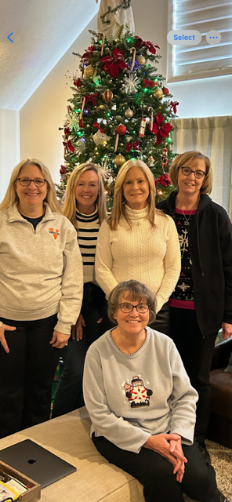
UVA Endoscopy Triage Team

Slide 28
Questions?
Cindy Gentry, RN, BSN, CGRN
UVA Medical Center
Digestive Health Center
Endoscopy Triage/ Navigation Team
2025

Slide 29
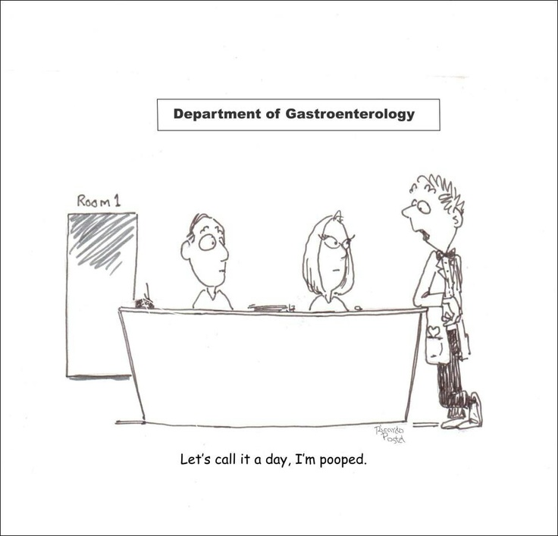

Slide 30
References/ Resources
American College of Gastroenterology | ACGChandrasekhara, V., et al. (2015). Open-access endoscopy. Gastrointestinal Endoscopy, 81(6), 1326–1329.
https://www.asge.org/home/resources/publications/guidelines/colorectal-cancer-screening-recommendations-for-physicians-and-patients-from-the-u-s‑multi‑society-task‑force‑on‑colorectal‑cancer.
https://www.giejournal.org › article › abstract, 2002.
U.S. Multi‑Society Task Force on Colorectal Cancer. Colorectal cancer screening: Recommendations for physicians and patients from the U.S. Multi‑Society Task Force on Colorectal Cancer. American Society for Gastrointestinal Endoscopy, 2020.
OpenAI. (2025). google (Mar 23 version) https://doi.org/10.1016/j.gie.2015.01.041 [Large language model]. https://chat.openai.com/chat,2025.
UVA Anesthesia Guidelines for UVA Outpatient Endoscopy Center/ UVA Endoscopy, 2022.

