Slide 2
Infection Prevention and Endoscopy
Lisa Brown, BPH, ACNA, AGTS, CER
Mid-Atlantic SGNA 2025 Fall Conference
November 15, 2025

Slide 3
Disclosures
I have no disclosures

Slide 4
Objectives
Review of guidance for endoscope reprocessing from regulatory and professional societies
  Association for the Advancement of Medical Instrumentation (AAMI)
  Society of Gastroenterology Nurses and Associates (SGNA)
  Association of perioperative Registered Nurses (AORN)
  The Joint Commission (TJC)
Review of source for infection prevention and control in endoscope reprocessing

Slide 5









Regulatory and Professional Societies

Slide 6
Manufacturer’s Instructions for Use (IFU)
AMMI ST91 | SGNA | AORN | TJC
Stresses strict adherence to manufacturer’s IFUs for all steps | Because the directive to follow the manufacturer’s validated instructions for use and reprocessing of endoscopes remains unchanged, it is necessary to stay vigilant with proper decontamination, cleaning and disinfection/sterilization, drying, and storage | Policies and procedures should reflect the manufacturer’s IFU and any variations in practice setting times, as they address the unique design features of specific instruments | The device manufacturer’s reprocessing instructions MUST be followed because only the manufacturer know the materials and components

Slide 7
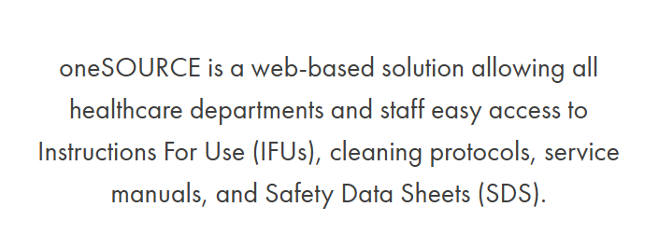
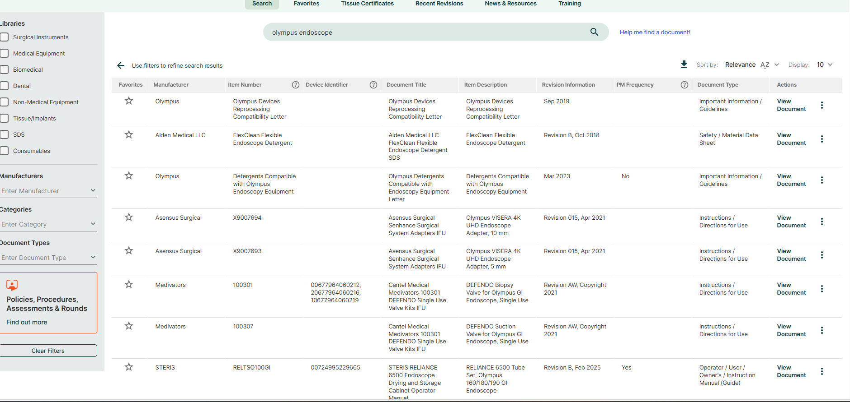
oneSource

Slide 8
Point of Use Treatment
(Pre-cleaning, Pre-treatment)
AMMI ST91 | SGNA | ARON | TJC
Name has changed from “precleaning” to “point of use treatment” Emphasizes to preform immediately after procedure per the IFU-flushing helps to remove excess soil and ensures that the channels are not blocked, debris is removed, and channels are moistened for further processing Hand off communication from point of use to the documentation area-time of completion | To be done immediately after use to remove organic material and decreases the biofilms, making more likely that subsequent reprocessing steps per IFU | To be done immediately after the procedure to prevent biofilm growth on the endoscope per the IFU | To be done immediately after use to decrease soil and minimize the formation of biofilm and before disconnection of the light source

Slide 9
Transport
AMMI ST91 | SGNA | AORN | TJC
Closed container or closed transport cart Must be labeled with a visible fluorescent orange, orange-red, or red label containing a biohazard legend and must meet OSHA requirements Must be nonporous, leak-proof on its sides and bottom, puncture-resistant, and large enough to accommodate a single endoscope without the need to over-coil the insertion or light guide tubes Transported in a horizontal position | Transport in a puncture-resistant and leak proof container that prevents exposing staff, patients, or the environment to potentially infectious organisms Must be labeled to indicate biohazardous contents Must be large enough to prevent damage to the endoscope by being coiled too tightly | Transported immediately Clean closed container Coiled in larger loops Container to be clean and disinfected after each use | Transported in a manner that does not allow cross-contamination Puncture-resistant, leak-proof on the sides and bottom Labeled in red or labeled biohazardous

Slide 10
Leak Testing
AMMI ST91 | SGNA | ARON | TJC
To be done before each manual cleaning to detect any damage to prevent fluid invasion or potential risk of cross-contamination Done with validate leak tester per IFU Automated leak testers should be on a calibration schedule with documentation Document results of leak test Conducting mechanical leak testing using an AER cannot substitute for the leak testing recommended in the endoscope manufacturer’s written IFU Report the leak test failure per organizational policy and procedure, including the endoscope product identification and traceability information Minimum of 60 seconds | To be performed prior to immersion of the endoscope in to solutions during manual cleaning per IFU Detects damage to the interior channels and exterior surfaces of the endoscope that can lead to inadequate disinfection and further damage | To be done after each use, after any event that may have damaged the endoscope, and before use of a newly purchased, repaired, or loaned endoscope Done with a verified leak tester (wet and/or dry) Document results Failures-remove from service per IFU and facility policy | Inspected for surface integrity Done per IFU of leak tester (e.g. dry or wet) Angulate knobs in all directions Good lighting when checking for bubbles (leaks) Perform test per endoscope IFU time frame Failures-OSHA requires fully decontamination labeled with biohazardous before transport

Slide 11
Manual Cleaning
AAMI ST91 | SGNA | AORN | TJC
“Critical step” requires meticulous manual cleaning including brushing and flushing lumens with validated FDA validated solution followed by visual inspection per IFU Should be done as soon as possible after leak test to prevent drying of soiled debris preventing biofilm formation Should be visually inspected for cleanliness, integrity, and function before use, during the procedure, after the procedure, after cleaning, and before disinfection or sterilization Lighted magnification 5x for endoscopes-duodenoscopes 10x Recommends borescope inspection | This is the most critical step in removing microbial burden from an endoscope. Manual cleaning is necessary prior to automated/manual HLD or sterilization. All steps should be completed sequentially and within the manufacturer’s time frame Visual inspection should be done during all stages of handling and reprocessing Considered a safety stop or “time out” Use magnification and adequate lighting | To be done in accordance of the IFU, after leak testing and before sterilization and HLD To be done in the recommended time from after the point of use per the IFU (usually 60 minutes) Follow delayed reprocessing IFU and facility policy Follow detergents, brushes, flushing units IFUs | Performed according to the IFU Some models require manual cleaning even if using FDA approved AER Endoscopes should be cleaned ASAP after use to prevent drying and biofilm formation Follow IFU for time frame from point of use treat to manual cleaning (varies from vendors) Use validated accessories (brushes, flushing equipment, AER, detergents, etc.) per IFU

Slide 12
Disinfection/Sterilization
AMMI ST91,, | SGNA | AORN | TJC
Promotes the use of Automatic Endoscope Reprocessors (AERs) per IFU Use only validated chemicals Provides guidance on their use (e.g. repeating the HLD cycle if the endoscope is left in the AER for more than an one hour Recommends against the manual HLD due human error variability) AER not meant to replace leak test and/or manual cleaning even if FDA approved Documentation of MEC and HLD achievement | Manual cleaning and HLD eliminates nearly all microorganisms The effectiveness of the high-level disinfectant depends on: • Effective pre-cleaning, manual cleaning, and rinsing to decrease the organic load and microbial content of the endoscope; • Drying after rinsing to avoid dilution; and • Proper preparation and use of the disinfectant in accordance with the manufacturer's directions Recommends usage of AER Use validate chemicals and equipment Documentation of cycle data FDA approved labeled AERs -do not require prior manual cleaning and channel brushing. strongly encouraged to perform both steps even when automated washing of endoscope channels is used. Strict compliance with duodenoscope reprocessing guidelines is necessary | Dry before sterilization or HLD Use verified AER and chemicals Monitor AER cycles to achieve parameters, temperature, contact times, etc.. Monitor water quality and filters Remove endoscope from AER promptly-if not (e.g. move than 1 hour) reprocess Handle with gloved hands | Dry before HLD Use validated chemicals Protect the safety of team members from potential exposures Use HLD products and equipment correctly Preform quality controls of the process (MEC) and document Complete proper documentation Documentation of HLD process/cycles Label chemical per IFU Maintain documentation of cycle data

Slide 13
Drying
AAMI ST91 | SGNA | AORN | TJC
Recommends a minimum of 10 minutes of forced instrument air (pressure-regulated) or a minimum of HEPA-filtered air per IFU Should never be stored wet or before decontamination has been completed | Strict compliance with duodenoscope reprocessing guidelines is necessary Moisture allows microorganisms to survive and multiply; therefore, all channels and the surface of the endoscope must be thoroughly dried before storage Thoroughly dried flushed 70% to 90% ethyl or isopropyl alcohol prior to be dried Flush with automated air for at least 10 minutes | To be done promptly after HLD according to the IFU (regardless of using immediately or storage) with regulated instrument air or HEPA-filtered air for a minimum of 1 minute unless other wise directed in the IFU) Preform drying even when using AER Verified automated drying system-10 minutes Lint-free cloth Borescope to inspect for dryness | Thoroughly dry to prevent growth of microorganisms Use medial air or use syringe to apply room air to dry channels per IFU Follow IFU of drying cabinets

Slide 14
Storage
AMMI ST91 | SGNA | AORN | TJC
clean, well-ventilated, and dust-free in order to keep the endoscopes dry and prevent exposure to potentially hazardous microbial contamination Stored in a manner that will protect them from damage or contamination and in accordance with the endoscope and storage cabinet manufacturers’ written IFU Stored suspended vertically or horizontally in a cabinet designed for storage in a way to allow circulation of air in accordance with the endoscope manufacturer’s written IFU | Must be visually inspected for cleanliness before storage Stored per IFU of vendor Should hang freely not damaged or contaminated by physical impact (e.g., endoscopes touching due to being stored too closely together). Cabinet-sufficient height, width, and depth to allow flexible endoscopes to hang vertically without coiling and without touching the bottom of the cabinet, or designed and intended by the manufacturer for horizontal storage of flexible endoscopes | Terminally sterilized endoscopes should be stored in a controlled environment Stored in a manner that minimizes contamination and protects for damaged per IFU Distinct visual cue of identify the endoscope is ready for use Secure location in clean area Stored with accessories Clean cabinet with documentation Do not store endoscopes in original shipping cases | Store in manner to protect from contamination and damage Inspect prior to storage and remove from service in repair indicated Differentiation between stored from repair vs. ready for use If stored in carrying case needs to be reprocessed before use Clean, well-ventilated, dust-free cabinet Stored vertically Protect tip from damage Should not touch the bottom of cabinet

Slide 15
Hang Time
AAMI ST 91 | SGNA | AORN | TJC
No recommendation Preform risk assessment There are a limited number of studies addressing this issue. The available data suggest that the risk of contamination is reduced when storage is performed according to the endoscope and storage cabinet manufacturers' written IFU | Length of storage “hang time” is a controversial issue, and there is no consensus between professional organizations supports a 7-day storage interval for reprocessed endoscopes but only if they were reprocessed and stored according to professional guidelines and manufacturer instructions. | Preform risk assessment to determine the maximum storage time will be considered safe to use with reprocessing Establish policy to identify expiring endoscopes | No recommended time frame Should have a policy that requires routine reprocessing

Slide 16
Cleaning Verification
AAMI ST91 | SGNA | AORN | TJC
REQUIRED after manual cleaning and visual inspection for “high-risk ” endoscopes. Basic components of user verification of cleaning efficacy are: a) select an appropriate rapid, easy-to-use test that represents a soil marker relevant to the devices used; b) establish reasonable benchmarks for the level of cleaning that can be achieved; and c) determine frequency of use based on facility factors (e.g., types and condition of devices, etc.) High-risk endoscopes and/or those that are of complex design (e.g., duodenoscopes, linear ultrasound (EUS) endoscopes, bronchoscopes, endobronchial ultrasound (EBUS) endoscopes, ureteroscopes, cystoscopes and as determined by the facility) shall be monitored with cleaning verification tests after each cleaning Recommends borescope inspection for lumens | Surveillance cultures remain the most reliable indicator of residual contamination on reprocessed endoscopes. The use of a borescope to inspect internal endoscope channels has been suggested. Borescopes may be useful in the initial training and annual verification of competency. | Inspect for cleanliness, integrity, & function for use during & after procedure, after cleaning, before sterilization or HLD Cleaning verification-before sterilization or HLD upon purchase and at established intervals according to IFU Lighted magicifiaction-X10 Use of borescope Documentation of results | No recommendations

Slide 17
Microbiological Surveillance
AMMI ST91 | SGNA | AORN | TJC
Recommends following the Duodenoscope Surveillance Sampling and Culturing Protocols from the FDA, CDC, and American Society for Microbiology | Currently, manufacturers and US regulatory agencies do not require routine use of microbiologic testing for quality assurance of reprocessed endoscopes. If such techniques are used then facilities should follow current standard microbiological techniques provided by the CDC and/or FDA | Interdisciplinary team including lab personnel to evaluate the program Follow the Duodenoscope Surveillance Sampling and Culturing Protocols from the FDA, CDC, and American Society for Microbiology Establish frequency for culturing, | No recommendation

Slide 18
Documentation
AMMI ST91 | SGNA | AORN | TJC
All recorded information may be incorporated into a paper log or preferably, an electronic record-keeping system or may be filed as individual documentation records All records should be retained for a period of time not less than that specified by state or local statues and legal considerations (e.g., statues of limitations for lawsuits). If statutes are not specific, record retention should be determined by the facility’s risks management personnel, legal counsel, and infection prevention and control personnel | Recommends process monitoring with documentation at all stages Documentation may include, but is not limited to, the following: • procedure date and time; • patient’s name and medical record number; • endoscopist’s name; • endoscope model and serial number or other identifier; • AER (if used) model and serial number or other identifier; and • names of individuals who reprocessed the endoscope | Maintain records per regulatory guidelines Patient ID Reprocessing dates and times Team member preforming steps Location of use Reprocessing step results (leak test, cleaning verifications, AER parameters, cycle results, achieved HLD, MEC results, etc.) Provider(s) name Endoscope unique identifier PM records for all equipment Repairs records | Track endoscope to patient by serial number or unique identifier from use of patient through HLD process Documentation for HLD cycles parameters including exposure time, disinfectant temperature, results of MEC or other quality control test to prove HLC achievement

Slide 19
Quality
AAMI ST91 | SGNA | AORN | TJC
Establishing policy and procedures, product identification and traceability, documentation and record-keeping, verification, and monitoring of the cleaning process, monitoring of high-level disinfection and sterilization processes, product recalls, and quality process improvement. Quality control is a critical aspect of endoscope processing procedures. In all cases, manufacturers’ written IFU, including those for the endoscope device, processing equipment, and other products used in processing, should be followed. Quality control also includes verification and monitoring of personnel performance, work practices, and adherence to established policies and procedures | Establish and implement an ongoing comprehensive quality assurance program include input from leadership, IP&C, risk management, and endoscopy personnel Audits should be observed using a checklist of critical steps for reprocessing Timing of reprocessing activities Evidence of equipment repair and maintenance/loaner Documentation verifying HLD achievement Documentation linking patient to endoscope/AER cycle Written policies and procedures on the roles and responsibilities Long term surveillance program | Use systems to approach quality assurance and performance improvement for preventions errors in endoscope reprocessing Preform audits for compliance per the IFU If a breach occurs include IP&C, interdisciplinary team, and risk management Assess water quality and filtration Establish schedule for preventive maintenance for devices and equipment per IFUs Report adverse events | Establish policies and procedure according to guidelines facility is following

Slide 20
Competencies
AMMI ST91 | SGNA | AORN | TJC
All personnel performing endoscope processing shall complete formal training and competency verification in all aspects prior to first assignment to perform these tasks independently Should be certified in flexible endoscope processing within two years of employment and should maintain that certification throughout their employment Shall be provided education, training, and complete competency verification activities related to their duties upon initial hire; annually; at designated intervals; or whenever new endoscope models, new processing equipment, or products such as new chemicals are introduced for processing. | Trained upon hire and have ongoing documented competencies in the safe handling of HLD/sterilant, and spill containment procedure per IFUs | Upon hire Annually or more frequently intervals as determined by organization Before new endoscope, accessories, cleaning processing solutions, equipment including loaned equipment, or procedures are introduced Whenever there are updated IFUs Any time a breach in processing is identified through quality assurance measures | Trained upon hire and have ongoing documented competencies in the safe handling of HLD/sterilant, and spill containment procedure per IFUs

Slide 21
Policies
Policies should state the recommendation of what guidelines you are following.

Slide 22
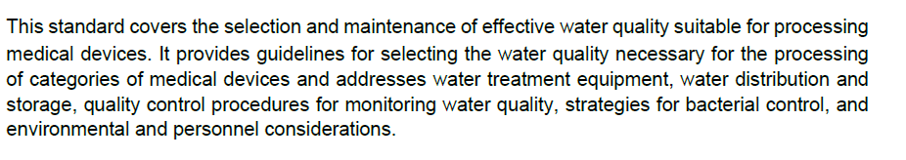
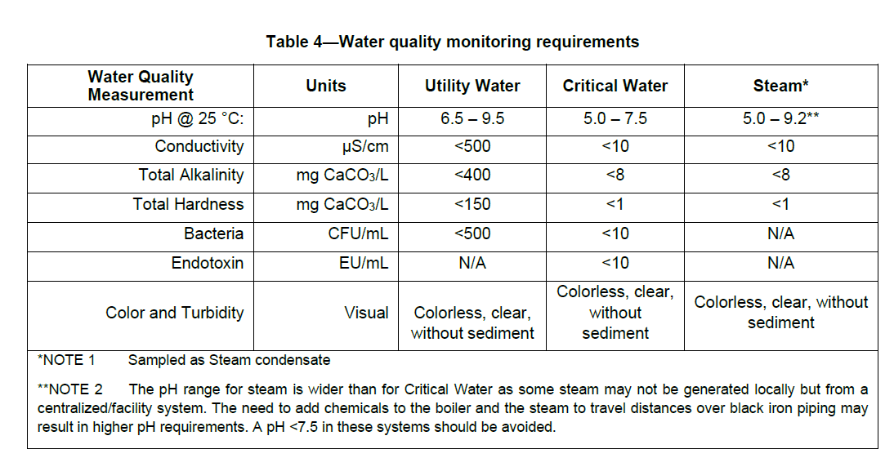
Water Sampling Program
AAMI ST-108

Slide 23
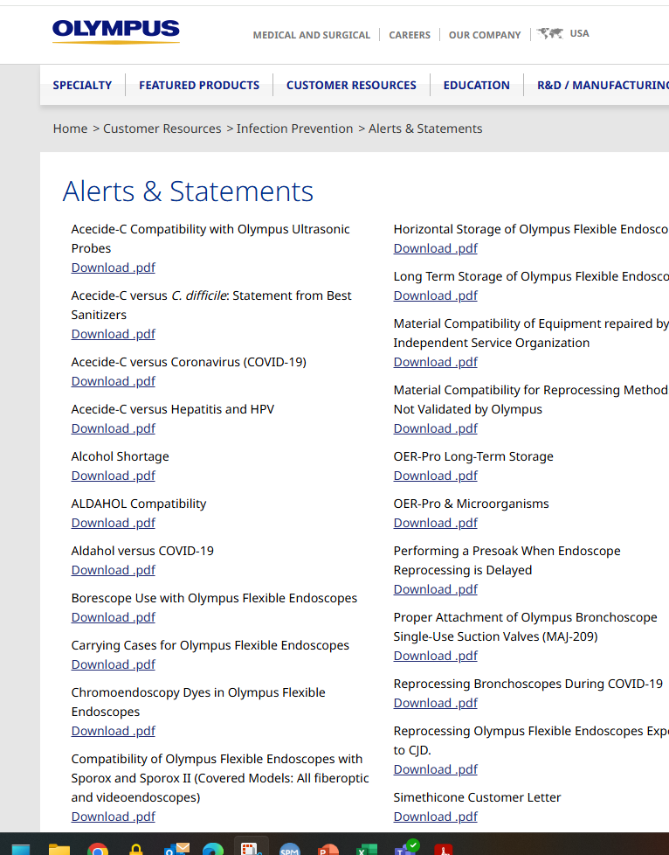
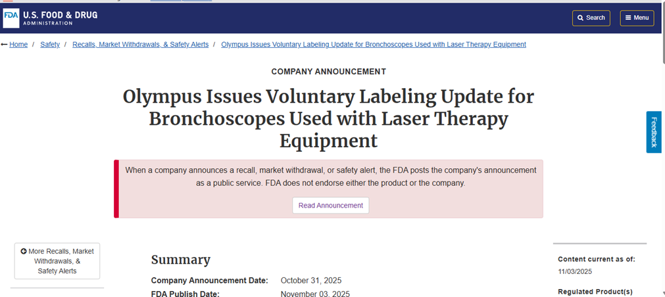
Alerts
Vendor alerts
FDA alerts/recalls

Slide 24
MAUDE
The MAUDE database houses medical device reports submitted to the FDA by mandatory reporters (manufacturers, importers and device user facilities) and voluntary reporters such as health care professionals, patients and consumers.
https://www.accessdata.fda.gov/scripts/cdrh/cfdocs/cfmaude/search.cfm

Slide 25
HICPAC
CDC’s Healthcare Infection Control Practices Advisory Committee (HICPAC)
Healthcare facilities should have a reliable, high-quality system for endoscope reprocessing which minimizes infection risks. To achieve this goal, all reprocessing programs must have an infrastructure that supports training and competencies, quality measurement, and management. The following guidance is provided to assist healthcare facilities, including clinical and administrative staff, to achieve a reliable, high-quality reprocessing program.
https://www.cdc.gov/hicpac/media/pdfs/essential-elements-508.pdf

Slide 26

Questions?

Slide 27
References
AAMI ST91: Reprocessing of Reusable Flexible and Semi-Rigid Endoscopes in Healthcare Facilities (2022)
SGNA: Standards of Infection Prevention in Reprocessing Flexible Gastrointestinal Endoscopes (2023)
AORN: Guidelines for Perioperative Practice (2025)
The Joint Commission: The Joint Commission Guide to Reprocessing Reusable Medical Devices (2023)

Slide 28


