Slide 1

Under Pressure: A Friendly Guide to Manometry
Presented By:
Annette McVey, MSN RN CGRN
Mid-Atlantic SGNA

Slide 2

Disclosure
I do not have any financial disclosures

Slide 3
Learning Objectives
Identify the anatomy and physiology of the esophagus.
Define esophageal manometry and its purpose.
List clinical indications and contraindications.
Outline steps for performing esophageal manometry.
Interpret common abnormal findings.

Slide 4
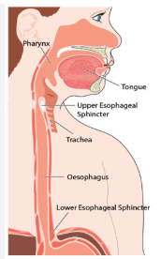
Anatomy of the Esophagus
The esophagus is a muscular tube approximately 25 cm long.
Connects the pharynx to the stomach.
Composed of upper esophageal sphincter (UES), body, and lower esophageal sphincter (LES).
Function: Transport food and liquid from mouth to stomach via peristalsis.
Innervation: Controlled by vagus nerve and enteric nervous system.

Slide 5
What is Esophageal Manometry?
Esophageal manometry measures the pressure and motility of the esophagus.
A thin, pressure-sensitive catheter is inserted through the nose into the stomach.
Assesses the coordination and strength of esophageal muscle contractions.
Often used to diagnose motility disorders such as dysphagia, achalasia or esophageal spasm.

Slide 6
Indications for Esophageal Manometry
Evaluation of dysphagia (difficulty swallowing).
Non-cardiac chest pain.
Pre-operative assessment for anti-reflux surgery or lung transplant.
Unexplained regurgitation or reflux symptoms.
Assessment of suspected motility disorders

Slide 7
Contraindications
Recent esophageal or gastric surgery.
• Esophageal perforation or obstruction.
• Severe coagulopathy or bleeding disorders.
• Large hiatal hernia making catheter placement difficult.
• Severe nasal obstruction or recent nasal trauma.

Slide 8
Pre Procedure Instructions
Stop taking medications
  Calcium channel blockers
  Nitrates
  Opioids
  Muscle Relaxers
NPO after midnight

Slide 9
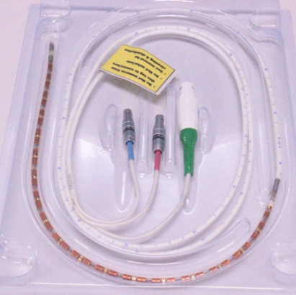
The High-Resolution Manometry probe
HRM probe
32 to 36 pressure sensors placed 1 cm apart
18 impedance sensors

Slide 10
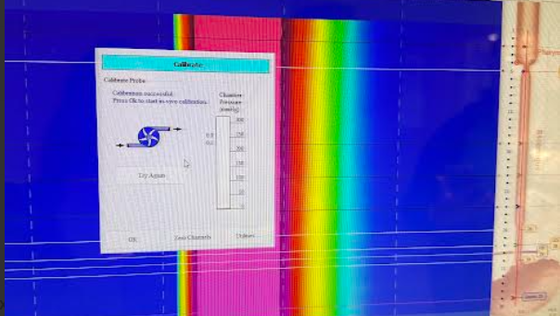

Slide 11
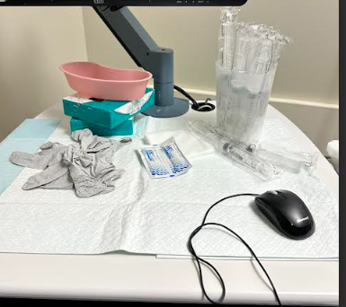
Set up
  Saline flushes
  Gloves
  4x4
  Lube/ topical anesthetic
  Tissues
  Bean or emesis bag

Slide 12
Performing Esophageal Manometry
Explain the procedure to the patient and obtain consent (if applicable).
Apply topical anesthetic to the nasal passage.
Insert the manometry catheter transnasally and positioned 2-3 cm below the diaphragm .
Confirm placement by pressure readings.
Instruct patient to perform wet swallows
  10 wet swallows laying down, 4 wet swallows sitting up
Record and analyze pressure data across UES, esophageal body, and LES.

Slide 13
Troubleshooting
Difficulty Passing the Probe
  Re-adjust as needed
  Rotate catheter during advancement
  Offer water to swallow
  LUB, LUB, LUB mixed with anesthetic
Difficulty Identifying Lower Esophageal Sphincter (LES)
  Hiatal hernia
    Have patient stand up
Excessive Patient Gagging or Discomfort
  Coach patient with breathing techniques
  Offer breaks
  Withdraw catheter

Slide 14
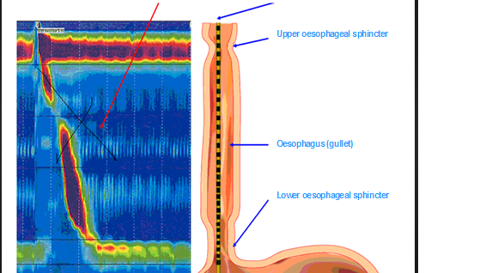

Slide 15
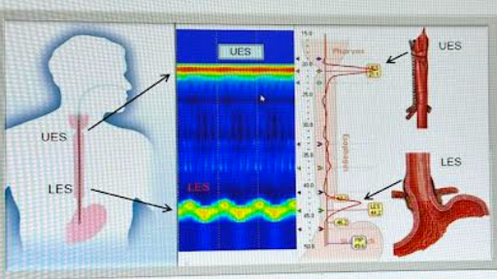

Slide 16
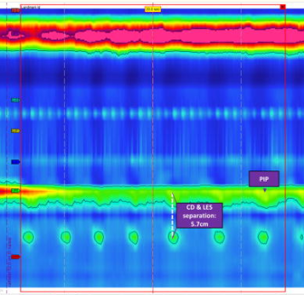
Baseline Pressure

Slide 17
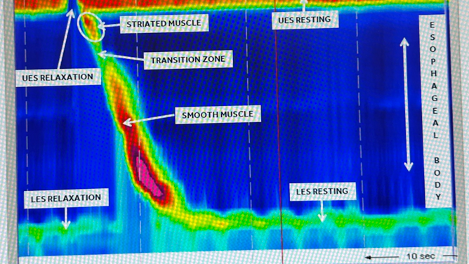

Slide 18
Abnormal Manometry Findings
Achalasia - Incomplete LES relaxation and absent peristalsis.
Esophageal Spasm - Simultaneous, uncoordinated contractions.
Ineffective Esophageal Motility (IEM): - Weak or failed contractions.
Hypercontractile (Jackhammer) Esophagus -Excessively strong contractions.
Hypotensive LES - Weak sphincter pressure leading to reflux.

Slide 19
Summary
• Esophageal manometry is key in diagnosing motility disorders.
• Helps differentiate causes of dysphagia and chest pain.
• Procedure is safe when proper indications and precautions are followed.
• Understanding normal vs. abnormal patterns guides treatment decisions.

Slide 20
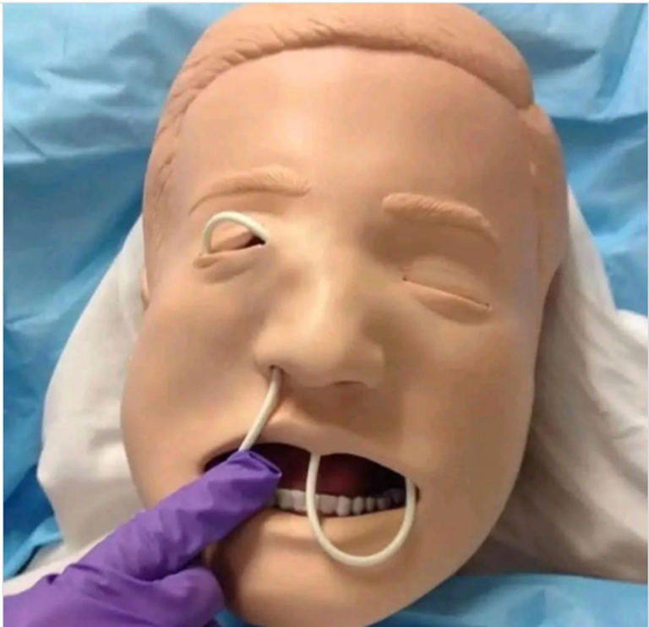
Questions

Slide 21
References
Baldwin, D., & Puckett, Y. (2020). Esophageal manometry.
Patel, D. A., Yadlapati, R., & Vaezi, M. F. (2022). Esophageal motility disorders: current approach to diagnostics and therapeutics. Gastroenterology, 162(6), 1617-1634.
Yadlapati R. (2017). High-resolution esophageal manometry: interpretation in clinical practice. Current opinion in gastroenterology, 33(4), 301–309.

